Slide 1

Multi modal ensemble based sarcasm detection model on
social media platform
Capstone project Report
Review
2003A51181 BONEPELLI UDAY REDDY
2003A51015 ADEPU SATHWIKA
2003A51122 GUGGILLA MADHAN KUMAR
2003A51274 NALLATHEEGALA PUSADATTA
2003A51228 POSHALA AKSHAY
Under the Guidance of
Mr. T B Prasad Reddy
Asst . prof

Slide 2
Abstract
Sarcasm detection on social media is a complex task that requires a deep understanding of text and audio cues. This project introduces a multi-modal ensemble approach that integrates text and audio modalities for improved detection. The text-based approach uses a TensorFlow-based neural network to capture subtle language patterns, while the audio component transforms speech into text and extracts Mel-frequency cepstral coefficients (MFCC) from audio signals. The fusion of these features forms a comprehensive representation of the audio context, and a Random Forest classifier classifies the audio as sarcastic or non-sarcastic. This innovative approach advances sarcasm detection on social media platforms and highlights the effectiveness of a multi-modal approach in capturing diverse dimensions of online communication.

Slide 3
Core Innovation:
Amalgamation of text and audio features.
Concatenated features fed into a multi-modal ensemble model.
Multi-Modal Ensemble Model:
Leverages Random Forest for superior performance.
Capitalizes on the complementary nature of linguistic and acoustic cues.
Framework Impact:
Advances sarcasm detection on social media platforms.
Demonstrates efficacy in capturing diverse dimensions of online communication.
The proposed framework is a breakthrough in sarcasm detection, showcasing the power of a multi-modal approach.

Slide 4

4
Introduction
Multi-Modal Approach: Pioneering sarcasm detection on social media, this project integrates textual and audio data.
TensorFlow Neural Network: Utilizes a TensorFlow-based neural network for precise text-based sarcasm detection, enhancing accuracy.
Audio Component: Employs speech-to-text conversion and Mel-frequency cepstral coefficients for audio-based sarcasm analysis.
Random Forest Classifier: Features a Random Forest classifier for audio data, contributing to a robust detection model.

Slide 5

Innovation in Integration: The project innovatively combines textual and audio features, elevating overall accuracy and reliability.
Ensemble Model: The multi-modal ensemble model collectively analyzes both feature sets, offering a nuanced understanding of sarcasm.
Significant Contribution: Advances sarcasm detection on social media, crucial for navigating the intricate dynamics of online platforms.

Slide 6

Problem statement
This project addresses the challenge of computer programs struggling to detect sarcasm in social media conversations. We aim to develop a sophisticated computer program with dual capabilities: understanding written language using a unique method for text and interpreting sarcasm in audio clips. By combining these abilities through ensemble learning, our goal is to create a highly intelligent computer system proficient at accurately identifying sarcasm in the diverse landscape of social media communication.

Slide 7

Literature Review
1. An Innovative Approach to Sarcasm Detection in Social Media Texts:
This summary outlines Liu et al.'s novel technique for detecting sarcasm in social media texts. The research explores sarcasm features on English and Chinese platforms, deriving qualities for detection. Introducing the Multi-Strategy Ensemble Learning Approach (MSELA), it combines various methods to address the imbalance between sarcastic and non-sarcastic texts. Applied to English and Chinese datasets, MSELA outperforms other approaches in performance and resilience. Crucially, the article introduces innovative ways to teach sarcasm detection, particularly in identifying multimodal sarcasm in social media texts.
2. A Deep Learning Approach for Sarcasm Detection in Text Data:
Mehndiratta et al. introduce a novel sarcasm detection method using deep convolutional neural networks (CNNs). They examine sarcasm features in tweets, Weibo, and Netease forum, proposing attributes capturing cues in text or image. The paper presents a skip-gram based CNN model converting words to vectors for identifying sarcasm and irony in social media text. Testing on English and Chinese datasets, the method proves more effective than other techniques, offering an innovative and improved approach to sarcasm detection in diverse texts.

Slide 8
3. A New Approach to Hybrid Document Features Extraction:
Zhibo et al. present an innovative document feature extraction method using latent Dirichlet allocation (LDA) and Word2Vec. Combining global and local word and document relationships, the approach employs a bag-of-distances technique for measuring semantic similarity between documents. Validated on datasets like 20 Newsgroups and Reuters-21578, the method enhances classification performance by integrating global and local relationships, contributing to efficient document feature extraction.
4. The above summary is for the work “A Novel Method for Word Similarity Computing Based on Word Em-bedding,”
” which is an article by Zhang et al It explains about given seed words, how to find other words with the same meanings using a process called feature extraction. In this paper, word embedding models are employed to train word vectors from large Wikipedia corpus with two different ways of extracting feature subspaces; prior statistical knowledge and negative sampling. Through experiments done on a dataset created from WordNet synonyms dictionary, the paper demonstrates how that can improve language comprehension. This represents another way of looking at how to solve the problem of calculating word similarities

Slide 9

5. Sarcasm Identification in Indonesian Social Media:
Lunando and Purwarianti propose a novel method for sarcasm detection in Indonesian social media. After sentiment analysis, their machine learning approach incorporates negative information and the count of interjectional words. Using translated SentiWordNet for sentiment classification, they evaluated the method on Twitter, Weibo, and Netease Forum, demonstrating improved accuracy and F1-score for sarcasm detection in Indonesian social media texts.

Slide 10

Objective
This project aims to enhance social media interactions by developing a sophisticated computer program for accurate sarcasm detection in written text and spoken words.
The user-friendly tool seeks to reduce misunderstandings, fostering a more enjoyable online experience. Beyond sarcasm, the multi-modal framework aims to improve sentiment analysis accuracy, contributing to a better understanding of emotional tones in digital conversations.
The overarching goal is to create a versatile tool for positive changes in how users engage with content across diverse social media platforms.

Slide 11
Proposed system
The Proposed approach for detecting sarcasm in both text and audio involves a combination of linguistic, acoustic, and contextual analysis.It leverages various techniques from natural language processing (NLP) for tet and speech processing for audio. Some of the methods we used in our proposed approach are BERT model, Random Forest Classifier, MFCCs feature extraction, Lexical feature extraction.

Slide 12
EXISTING METHODS VS PROPOSED METHOD
Existing method | Proposed method
Text-Based Sarcasm Detection: Rule-Based: Specific rules and patterns (words, punctuation). Machine Learning: Features like words, sentence structure, sentiment. Deep Learning: Advanced algorithms (neural networks) for high-level patterns. Challenges: Lack of labeled data, diverse expressions, contextual need, and evaluation metric standardization. | Multi-Modal Ensemble Approach: Combines text and audio features for enhanced sarcasm detection. Text Analysis: Utilizes neural networks for recognizing patterns. Audio Analysis: Employs a Random Forest classifier for sound interpretation. Addresses challenges of individual methods, enhancing accuracy in diverse online conversations.
Audio-Based Sarcasm Detection: Sound Analysis: Focuses on pitch and voice intensity. Speech Content Analysis: Considers meaning and structure of spoken words. Potential Applications: Sentiment analysis, opinion mining, chatbot development, cyberbullying detection. Challenges: Complex speech signals, audio data noise, subjective interpretation, lack of standardized evaluation metrics.

Slide 13
Implementation

Slide 14
Data Collection
The first crucial step in building a robust Sarcasm Detection Model is acquiring the necessary data.
We choose a meticulous approach to create a custom dataset by collecting text and audio from various sources, ensuring a diverse and representative set for our project.
We acquired a text-based dataset from Kaggle comprising 26,709 instances for sarcasm detection.This dataset forms the core of our project, emphasizing text-based sarcasm detection on social media platforms.
We employed the Mustard dataset for the audio component of our project, encompassing 690 utterance videos. This dataset plays a crucial role in training and enhancing the audio-based model within our multi-modal ensemble sarcasm detection framework.

Slide 15
PreProcessing
Preprocessing plays a critical role in ensuring that our data is in a suitable format for training our deep fake detection model.
During this stage, we performed tasks such as:
To train our multi-modal ensemble-based framework, we focused on a subset of 20,000 instances. Training set size -> 20,000 ; Testing set size -> 6,709
For text data our abjective was to convert raw textual information into a format suitable for training and analyzing sarcasm detection models.
For audio data, spoken words from auduio signals undergo a multi-step transformation.
Preprocessing the text data by tokenizing, removing stop words, and applying stemming or lemmatization.

Slide 16
Training and Modeling

Slide 17
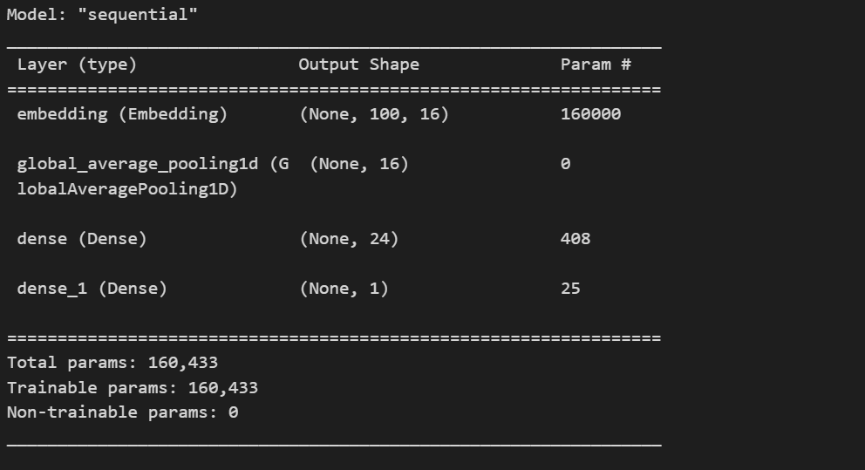
For Text:
The text modality model is a neural network tailored for precise text classification. The architecture begins with an embedding layer, translating words into dense vectors to encapsulate semaThe model is trained using binary cross-entropy loss and optimized with the Adam optimizer.ntic relationships.

Slide 18
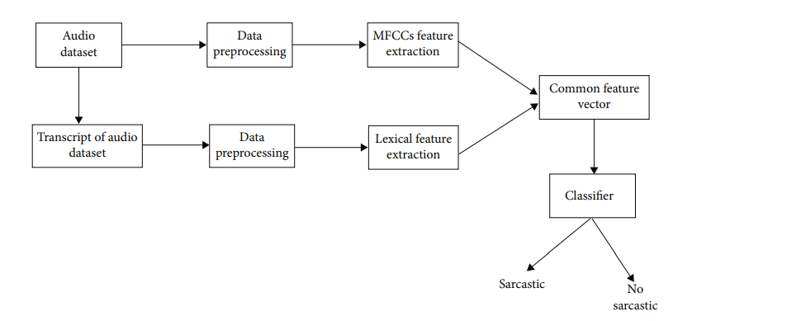
For Audio:
In the audio modality model, a random forest classifier is harnessed for its proficiency in handling high-dimensional data for effective classification.
Mel-frequency cepstral coefficients (MFCC) are extracted from audio signals, capturing essential acoustic features.
BERT embeddings derived from transcribed audio offer contextual information from the transcript.

Slide 19
Prediction
After the model was trained, we moved on to the prediction stage.
The model is now ready to analyze text and audio content in real-time.
During prediction:
The model processes the text data and classifies the text either as sarcastic or non-sarcastic.
The model processes the audio utterances into textual form and classifies the text either as sarcastic or non-sarcastic.
Real-time sarcasm detection is made possible by the successful implementation of our model.

Slide 20
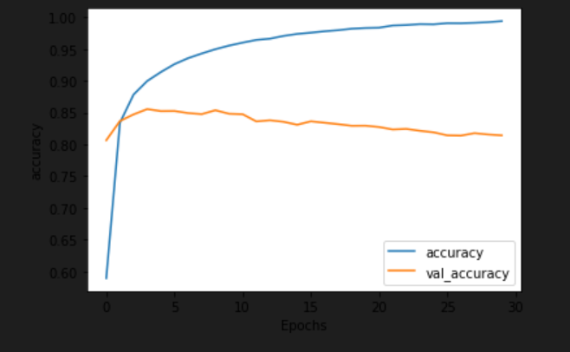
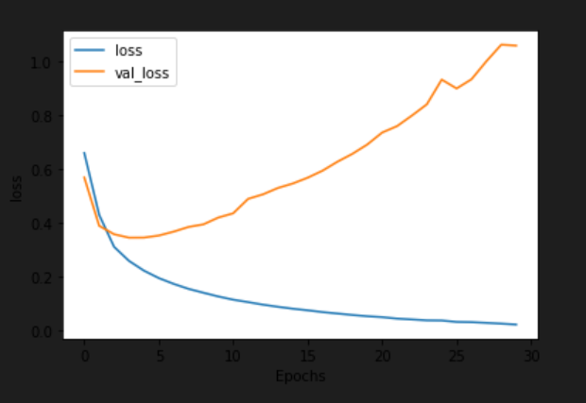
Results and Analysis
The sarcasm detection framework has undergone rigorous evaluation, employing both text and audio
modalities.
Text Modality:

Slide 21
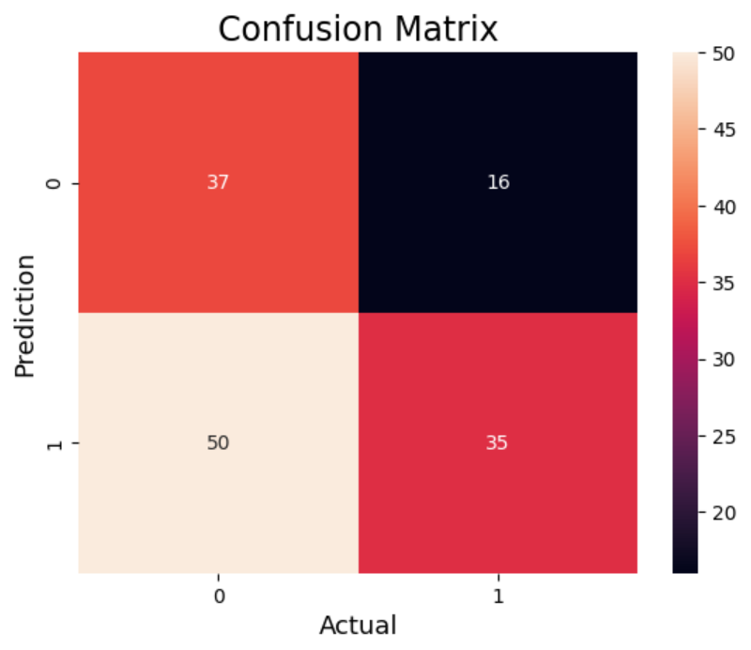
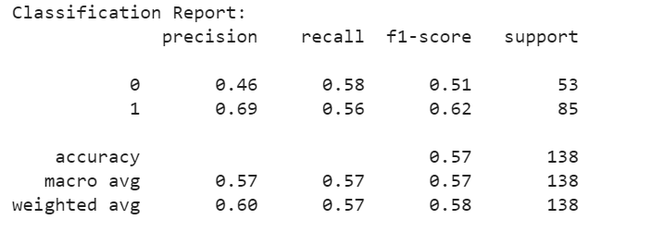
Audio Modality:

Slide 22
Future scope
The successful sarcasm detection framework opens doors for exciting enhancements:
1. Multimodal Fusion:
Explore advanced fusion techniques (e.g., attention mechanisms, transformers) for integrating text and audio cues, capturing nuanced relationships.
2. Model Fine-tuning:
Conduct extensive hyperparameter tuning and fine-tuning on diverse datasets and social media contexts, experimenting with neural network architectures and preprocessing techniques.
3. Real-time Detection:
Investigate real-time sarcasm detection on social media platforms, optimizing for low-latency predictions and deploying efficiently to accommodate dynamic content generation.
4. Adversarial Testing:
Assess model robustness against intentional adversarial attacks, enhancing resilience in real-world scenarios where users may try to deceive sarcasm detection algorithms.
5. Expand Dataset Diversity:
Extend the dataset to include diverse social media sources, linguistic styles, and cultural contexts for better generalization across demographics and languages globally.
6. Incremental Model Updates:
Implement continuous learning, enabling the model to adapt to evolving language trends and sarcasm expressions over time by regularly updating with new labeled data.

Slide 23
Conclusion
In summary, the Multi-modal Ensemble-Based Sarcasm Detection Framework adeptly tackles sarcasm identification in text and audio. Employing neural networks for text and a Random Forest classifier for audio, it attains commendable accuracy, emphasizing the value of diverse cue integration. Future directions involve advanced fusion techniques, real-time deployment, user-friendly interfaces, and continuous learning, positioning the framework as a valuable tool for nuanced sentiment analysis in the dynamic realm of social media communication.

Slide 24
References
[1] Liu, P., Chen, W., Ou, G., Wang, T.,Yang, D., Lei, K.: Sarcasm Detection in Social Media Based on Imbalanced Classification In: Web-Age Information Management, pp. 459-471. Cham, (2014).
[2] Mehndiratta, P., Sachdeva, S., Soni, D. :Detection of Sarcasm in Text Data using Deep Convolutional Neural Networks In: Scientific International Journal for Parallel and Distributed Computing, vol. 18, September (2017).
[3] Zhibo, W. , Ma, L., and Zhang, Y. : A Hybrid Document Feature Extraction Method Using Latent Dirichlet Allocation and Word2Vec. In : IEEE First International Conference on Data Science in Cyberspace, June (2016).
[4] Zhang, W., Xu, W., Chen G., Guo, J. : A Feature Extraction Method Based on Word Embedding for Word Similarity Computing. In: Communications in Computer and Information Science, vol. 496,pp. 160- 167 January, (2014).
[5] Lunando, E., Purwarianti, A. : Indonesian Social Media Sentiment Analysis With Sarcasm Detection. In: Int. Conf. Adv. Comput. Sci. Inf. Syst. ICACSIS, pp. 195- 198. September (2013).

Slide 25
Thank you

